Slide 1

Customer Shopping Behavior Analysis
Uncovering insights for strategic business decisions.

Slide 2


Project Overview
Transactional Data
Goal: Insights
3,900 purchases analyzed.
Spending patterns, segments, preferences.
Guide Decisions
Optimize strategy, reduce costs.

Slide 3

Dataset Summary
Key Features
Customer demographics
Purchase details
Shopping behavior
Missing Data
37 values in Review Rating.

Slide 4
Exploratory Data Analysis (Python)
01
02
03
Data Loading & Exploration
Missing Data Handling
Column Standardization
Pandas for import, df.info() & .describe() for summary.
Imputed Review Rating with median by category.
Renamed to snake_case for readability.
04
05
Feature Engineering
Database Integration
Created age_group and purchase_frequency_days.
Loaded cleaned data to PostgreSQL for SQL analysis.

Slide 5
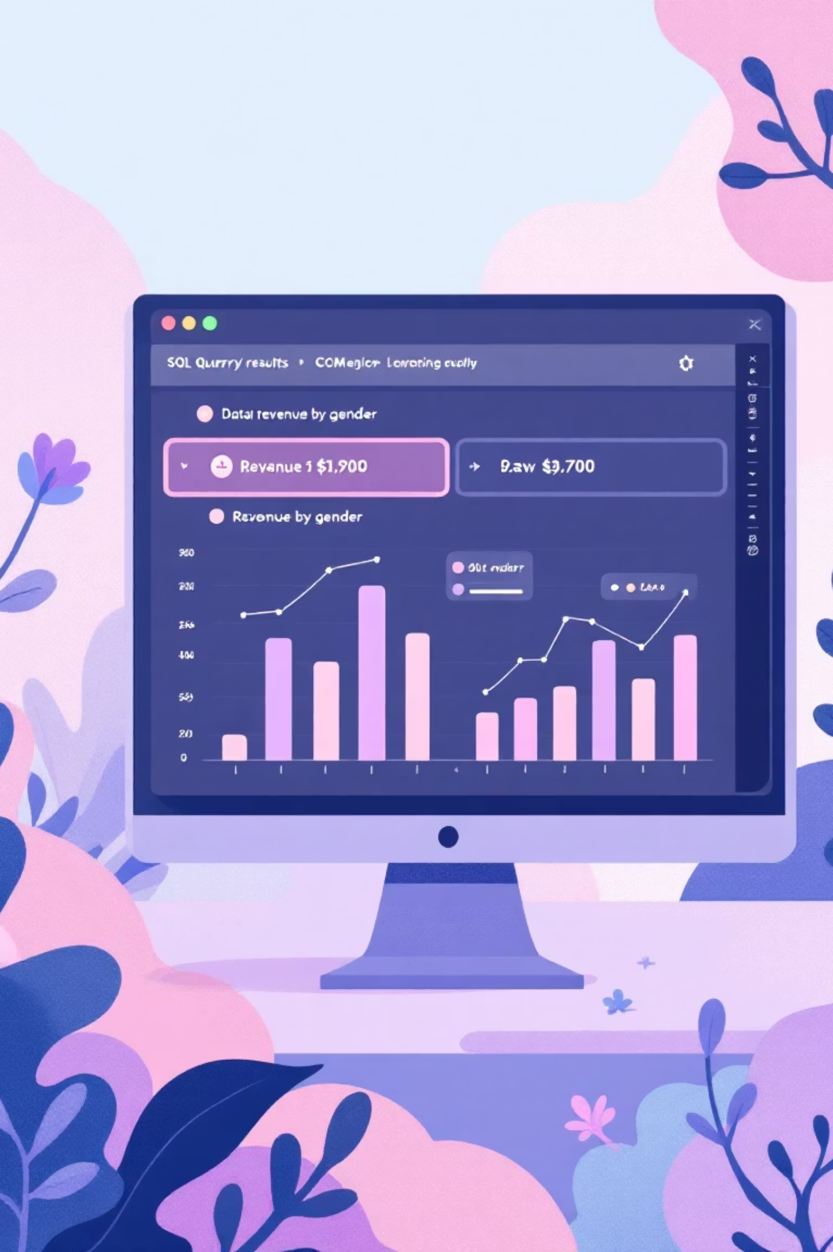
Data Analysis (SQL)
Key business questions answered through structured SQL queries.
1
Revenue by Gender
Male: $157,890, Female: $75,191.
2
High-Spending Discount Users
839 customers identified.
3
Top 5 Products by Rating
Gloves (3.86), Sandals (3.84), Boots (3.82).
4
Shipping Type Comparison
Express avg. $60.48 vs. Standard avg. $58.46.

Slide 6
SQL Insights: Subscriptions & Discounts
Subscribers vs. Non-Subscribers
Discount-Dependent Products
Hat (50%)
Yes
1053
59.49
62645
Sneakers (49.66%)
No
2847
59.87
170436
Coat (49.07%)
Sweater (48.17%)
Pants (47.37%)

Slide 7
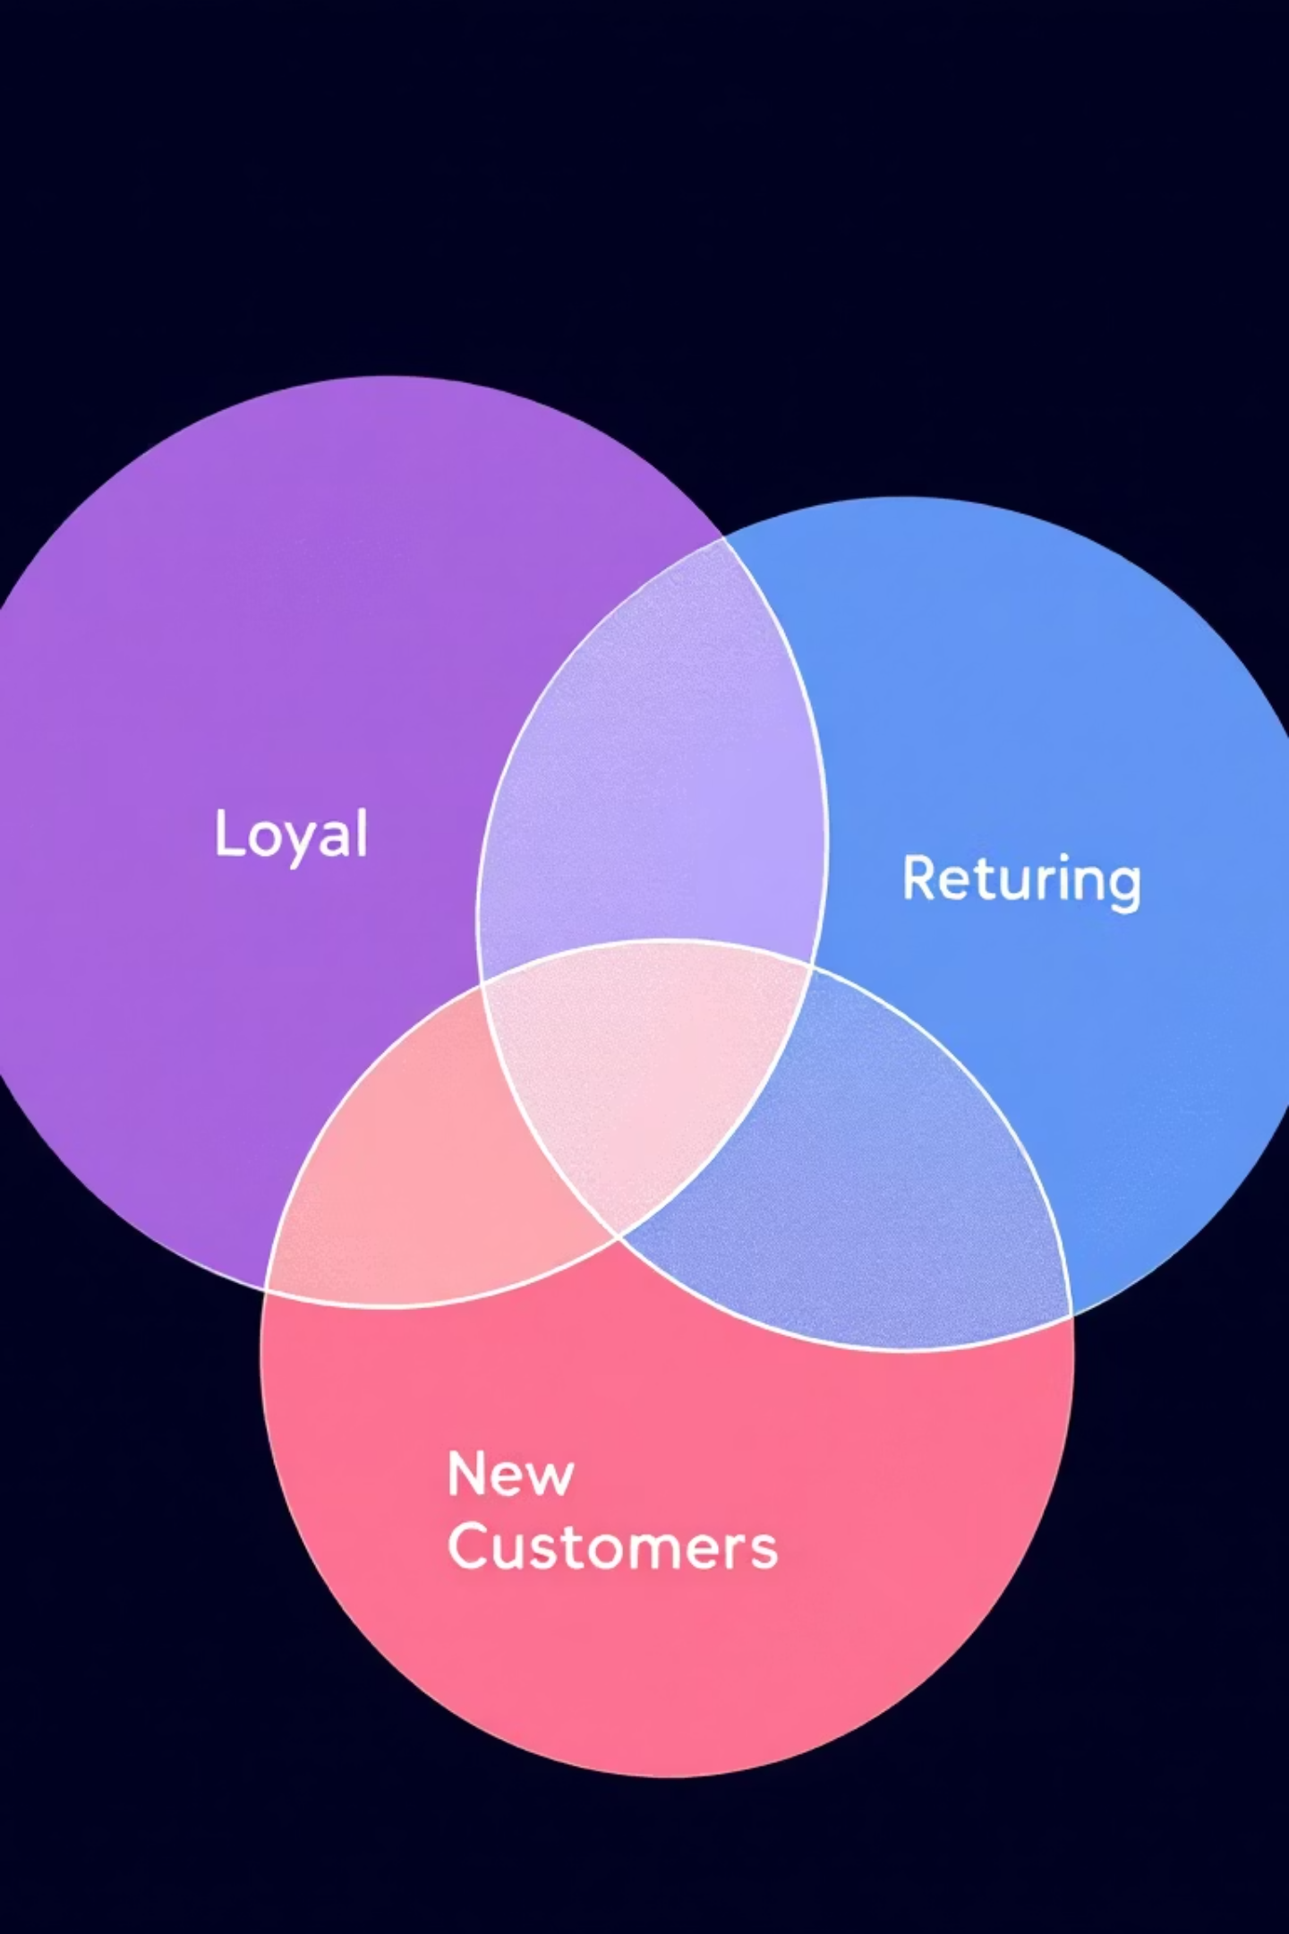
Customer Segmentation & Loyalty
Loyal Customers
Returning Customers
3116 customers.
701 customers.
New Customers
83 customers.
Repeat buyers (>5 purchases): 958 subscribers vs. 2518 non-subscribers.

Slide 8
Top Products by Category
1
Accessories
Jewelry
171
1
Clothing
Blouse
171
1
Footwear
Sandals
160
1
Outerwear
Jacket
163

Slide 9
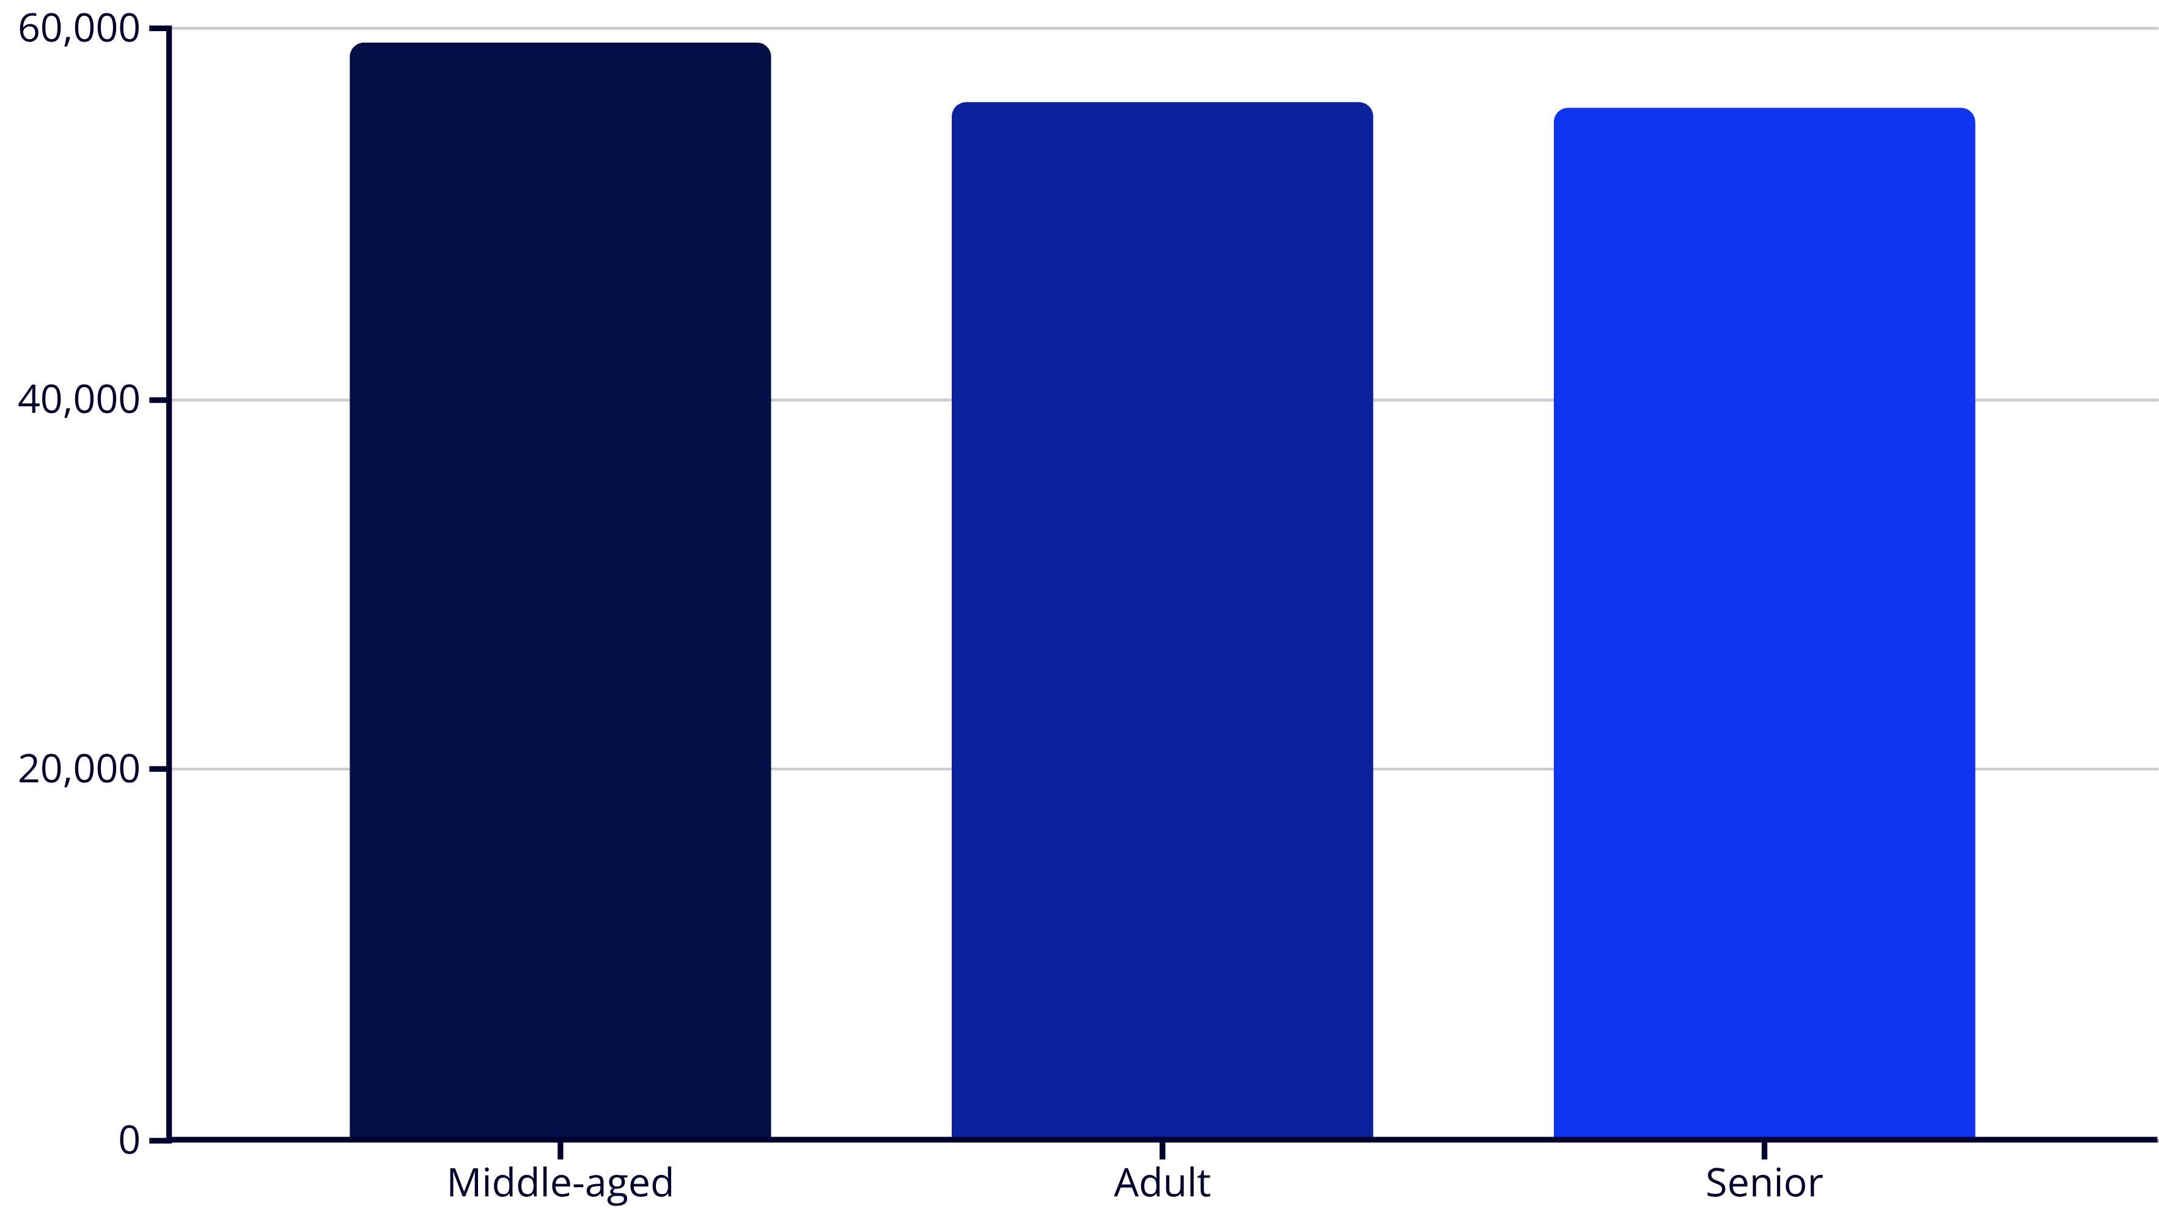
Revenue by Age Group
Young Adults contribute the highest revenue.

Slide 10
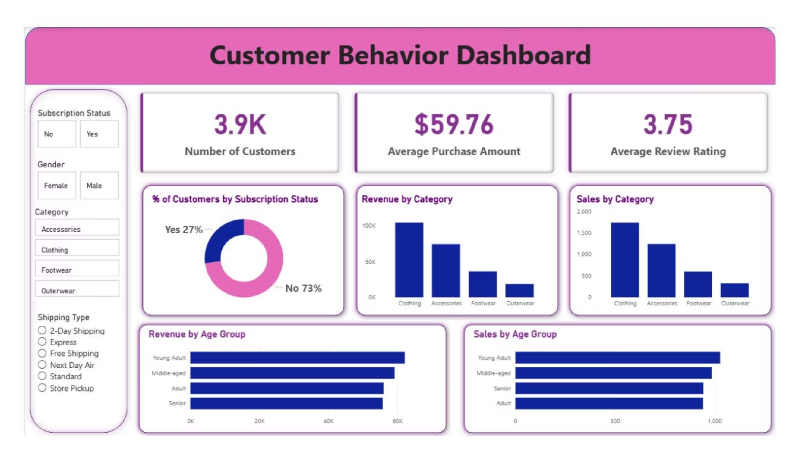
Business Recommendations
Boost Subscriptions
Promote exclusive benefits.
Customer Loyalty Programs
Reward repeat buyers.
Review Discount Policy
Balance sales with margin control.
Product Positioning
Highlight top-rated products.
Targeted Marketing
Focus on high-revenue age groups.

